Slide 1
Network Segmentation

Slide 2
Segmentation
Enables ZTNA across multi-region and multicloud, including on-premises environment
Group VNets/VPCs/VCNs/Apps with similar security policies
Define your own domains
Use Cases
Compliance
Governance
Audits

Slide 3
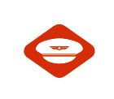
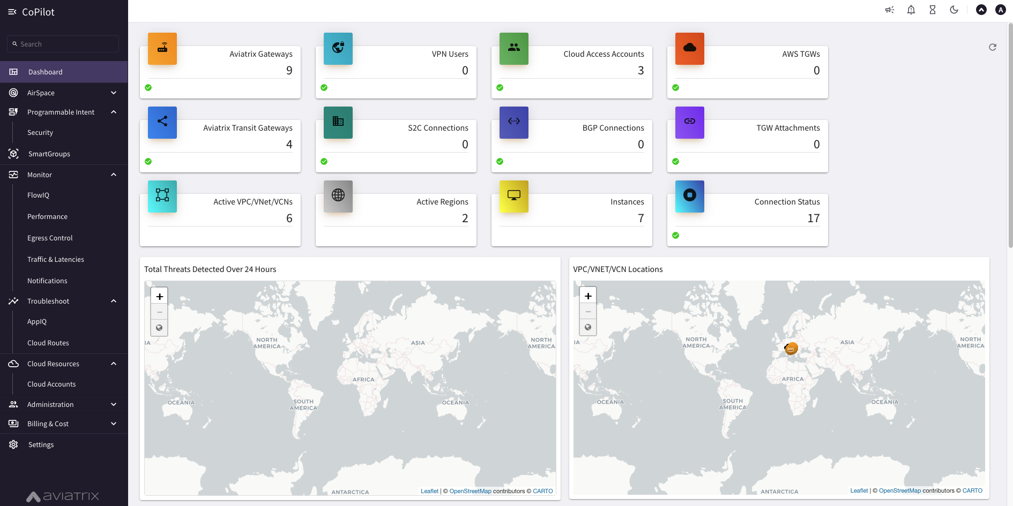
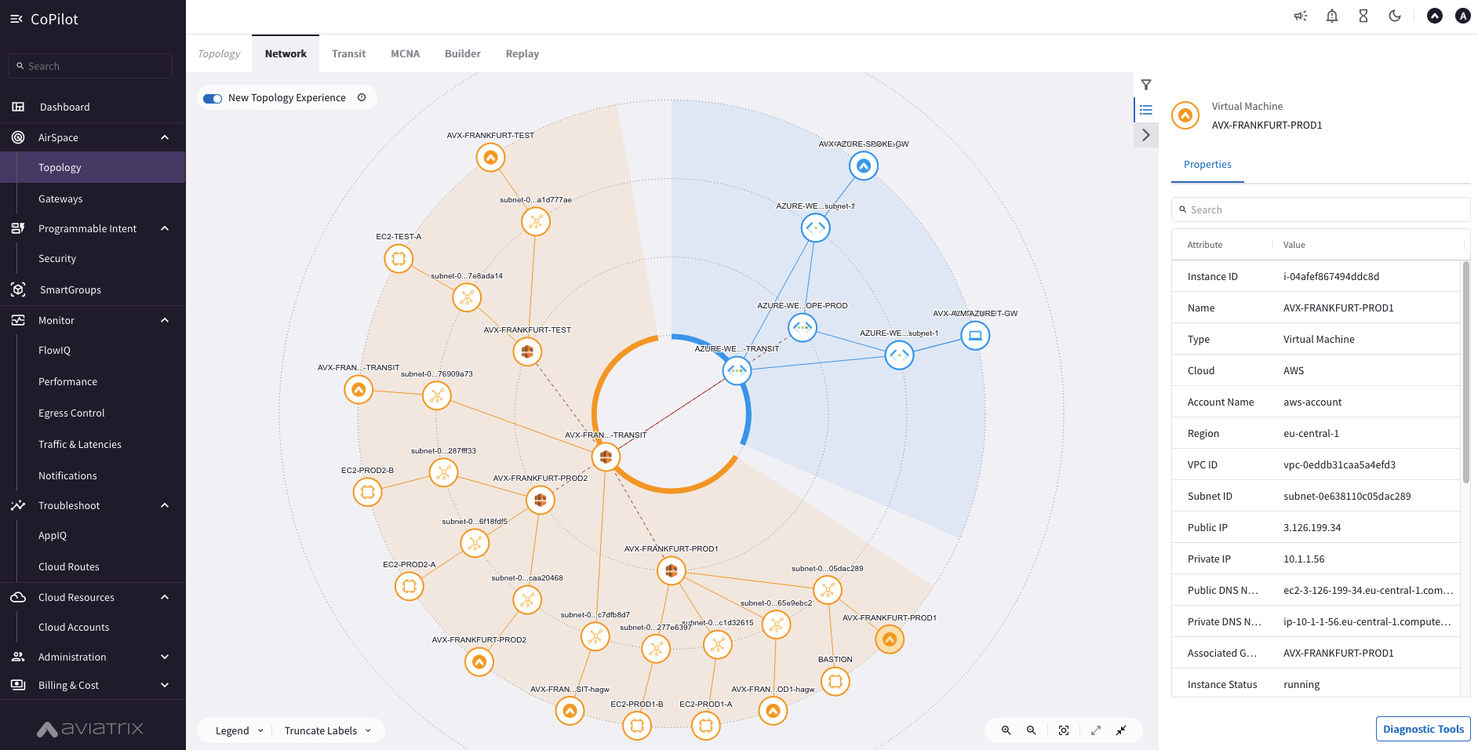
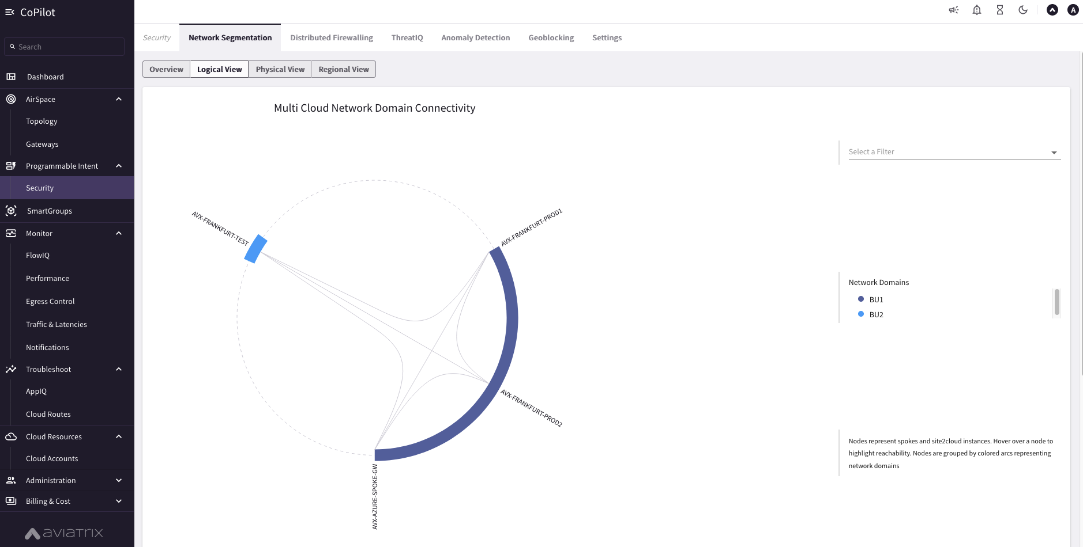
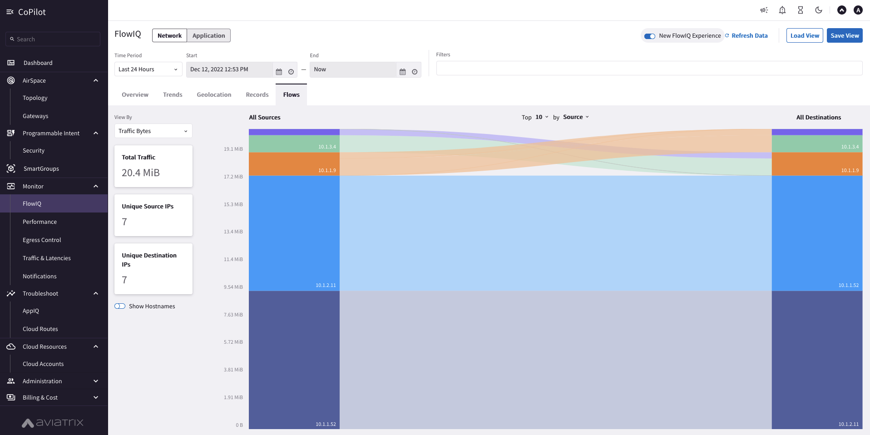
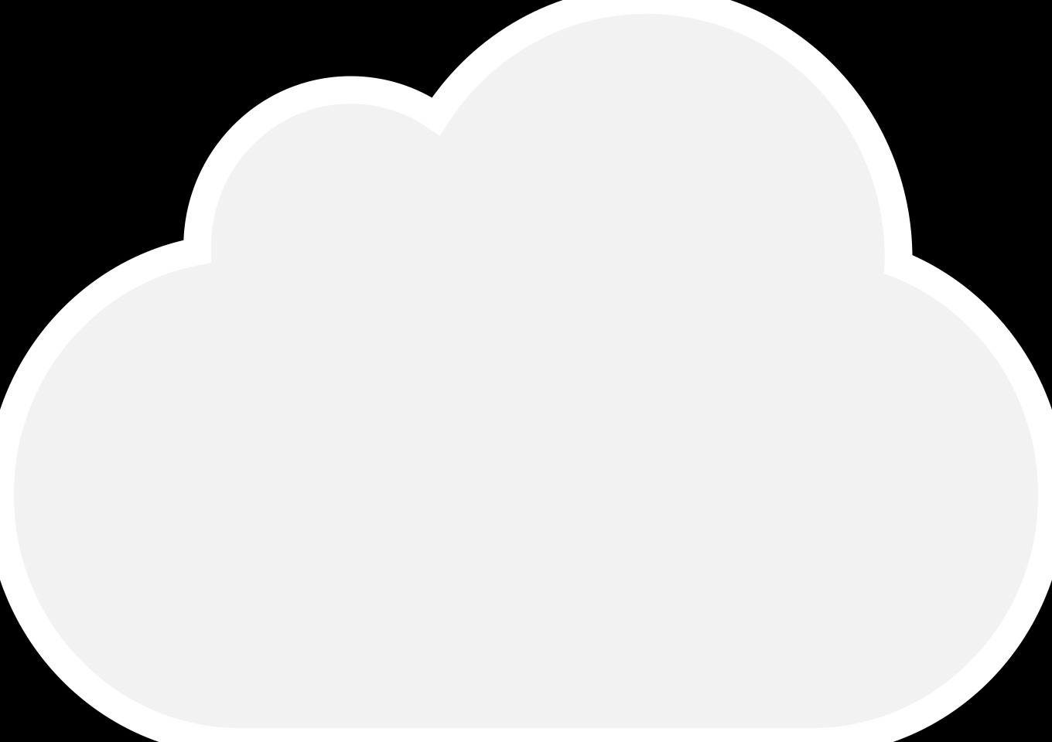
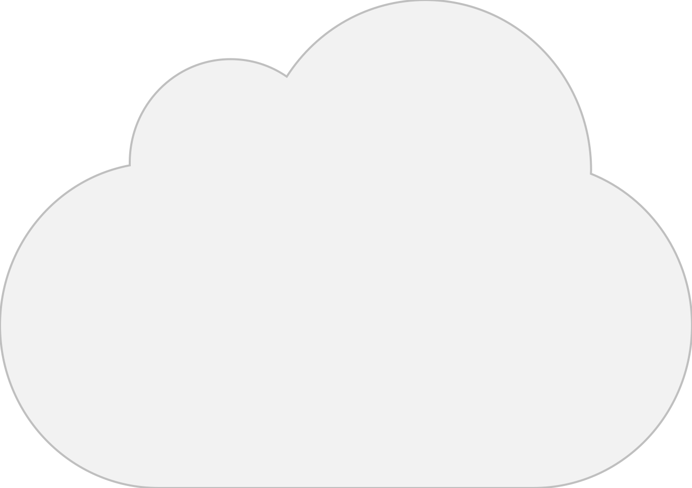

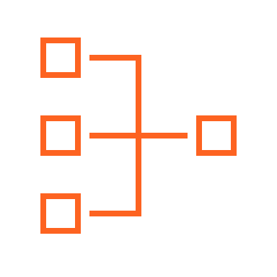

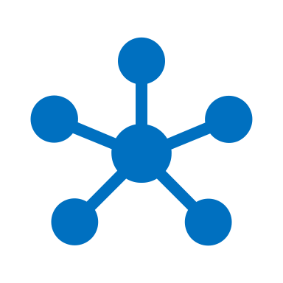
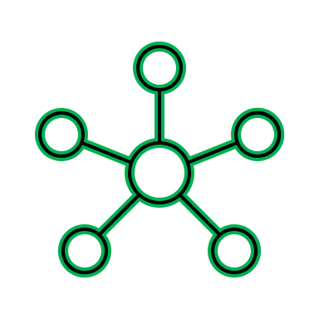

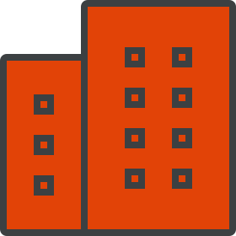
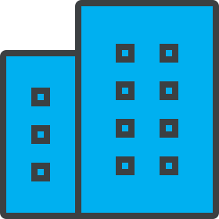
Cloud and Multicloud Network Segmentation
Aviatrix
CoPilot
Network Granularity and Control
VPC
VPC
VPC
VPC
VNet
VNet
VPC
VPC
VCN
VCN
Region 1
Region 2
Network Domains
Private Interconnect
LOB1
LOB2
LOB3
Notes:
The foundation of a zero-trust architecture in cloud is route segregation and control. Aviatrix makes implementing this foundation across your entire network simple and effective using network domains.
Network domains provide strict isolation between groups of VPCs/VNet and branch locations, anywhere across the entire Aviatrix network.
Because Aviatrix creates a distributed, consistent network between regions or clouds, Network Domains can be provisioned and built in just a few simple clicks in the GUI or by using Terraform.

Slide 4




Cloud and Multicloud Network Segmentation
Aviatrix
CoPilot
Policy Based Network Segmentation
Global
Consistent / Repeatable
Across accounts, subscriptions & projects
Cloud and Connection Agnostic
Single cloud
Intra-region or inter-region
Multiple clouds
Edge/Access Segmentation
On-Prem DCs
Branches
Extranets
Cloud Peering
On-Demand Compliance/Governance
Security Posture within minutes
Aviatrix control plane realizes the intent
Zero-Trust
Flexible
Automated
Blue Segment
Green Segment
Connection Policy
VPC
SS
VPC
VPC
VPC
VPC
VPC
VPC
VPC
VPC
VNet
VNet
VNet
Transit
VPC
FireNet
Transit
VPC
Transit
VPC
FireNet
Transit
VPC
Transit
VNet
FireNet
IT
BU1
BU2
IT
AWS - REGION1
GCP – REGION1
GCP – REGION2
AZURE - REGION1
DirectConnect
Site2Cloud
Site2Cloud
Express Route
Extranet
Extranet
BRANCH OFFICES
Data Center
Data Center
Notes:
MA/MR/MC environment (AWS/GCP/Azure) with 1 MSP managing it all. Just follow the color coding. Created segments (blue, green, purple (SS)). Blue is allowed to talk to any blue resources in any other cloud by default. Regardless of which cloud. Regardless of which access method.
If not desirable, then a new segment needs to be created, which will enable further isolation.
So you define a Segment or few, in this case.
Connected via Connection Policy
Now, what if Blue needs to talk to Green → Need Connection Policy. Similarly b/w Purple (SS) and Green. Zero-trust model. No communication allowed unless Connection policy defines it
By default, all communication within a segment is allowed. Across segments requires Connection Policy
It is Global. Not restricted to a single account or single region or single cloud
Security Posture bullet
It is Declarative, i.e. you declare what your desired state is to the Controller and the Controller will make it happen via routing updates and segmentation policies
Security - Enforce common security policies centrally across all public clouds.

Slide 5
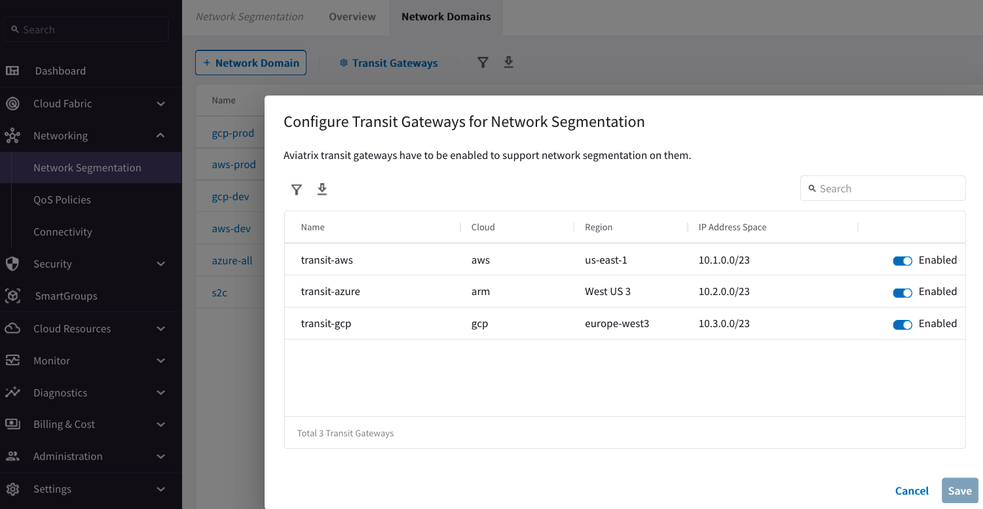
Network Segmentation
1- Enable Transit Gateway for Segmentation

Slide 6
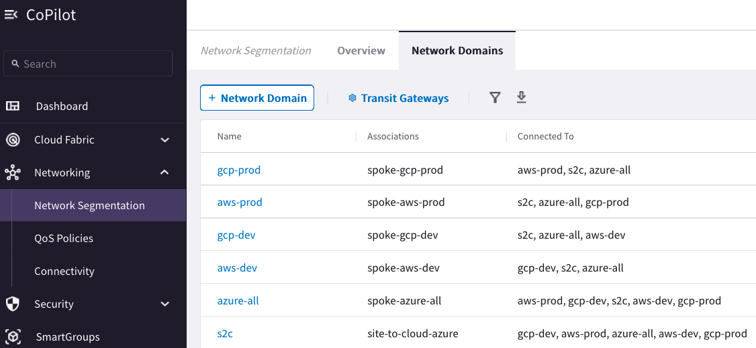
Network Segmentation
2- Create Network Domain (aka Network Segments – think of them as VRFs)
3- Create the association between Network Domains (aka Network Segments)

Slide 7
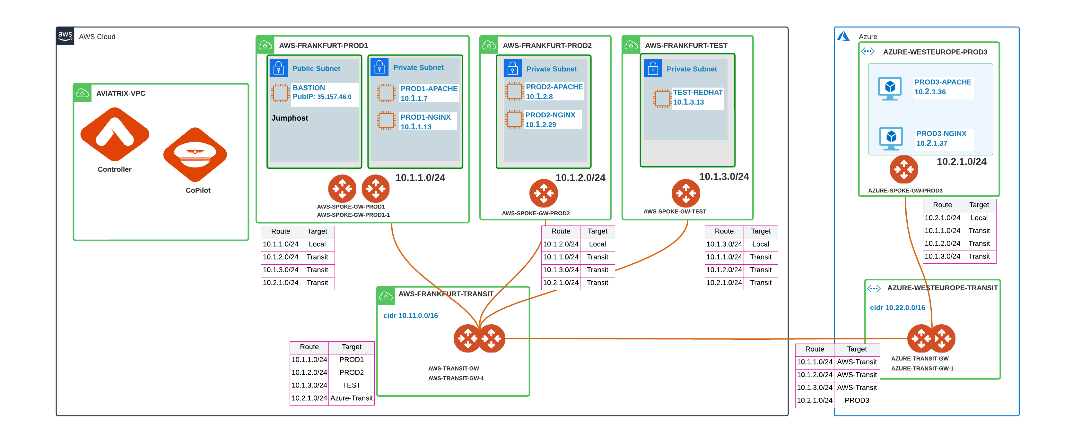
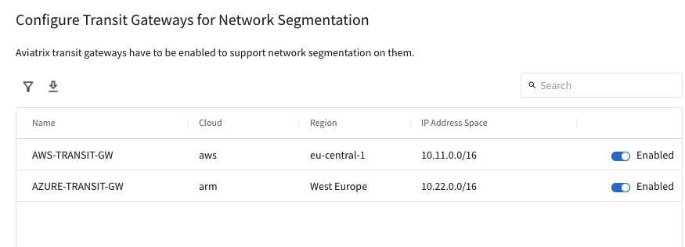
1. Enabling a Transit Gateway for Network Segmentation
Enable the Network Segmentation:
Choose the Transit Gateway(s) that will route traffic for its members.

Slide 8
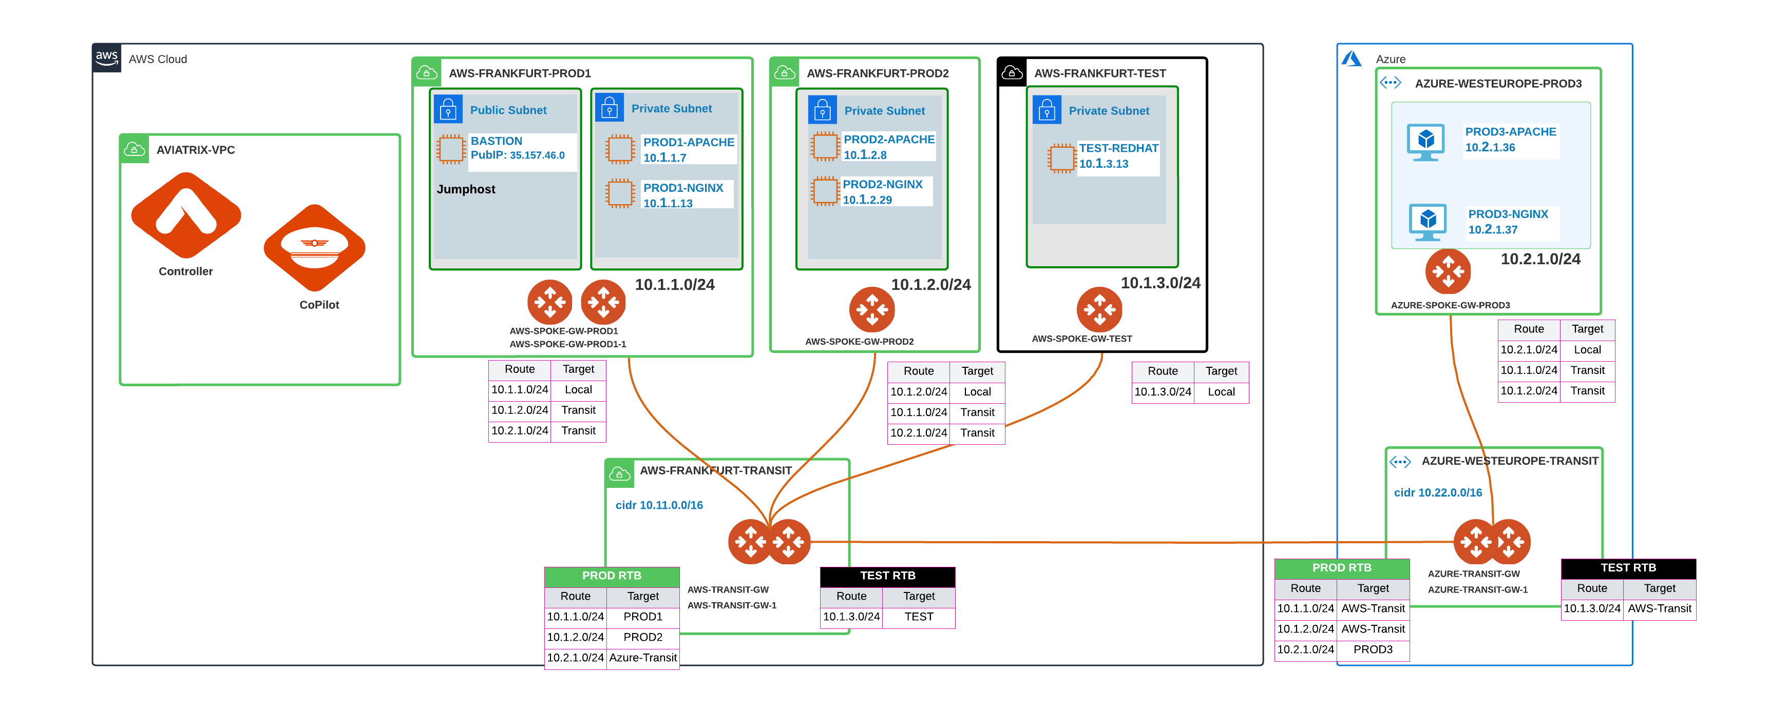
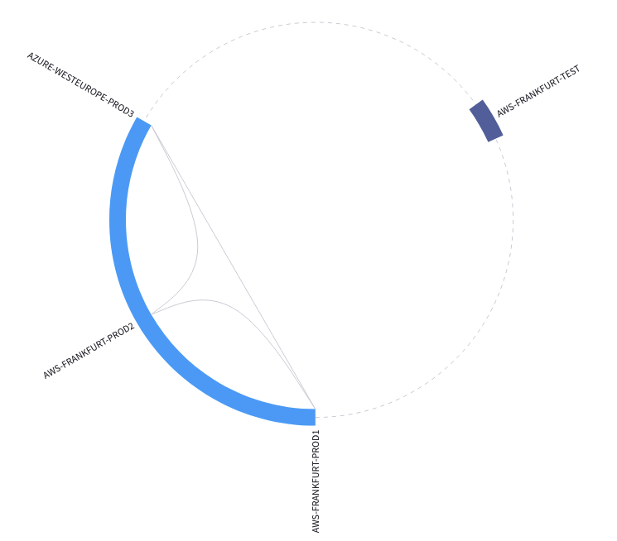
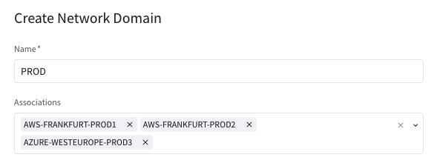
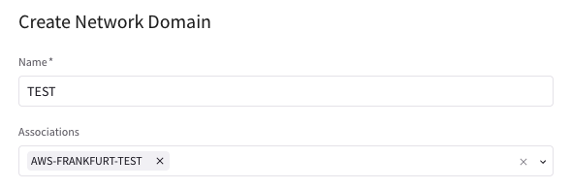
2. Creating, Connecting, and Associating a Network Domain
Transit Gateway
Multiple RTBs (per each Network Domain)
Main RTB:
The main RTB will host the Transit Routes (i.e. the routes of the backbone layer) and the routes that belong to Unmanaged Network Domains (i.e. VPCs/Vnets not assigned to any Network Domains).
Spoke Gateway
Single RTB (Main)
Create the Network Domains:
Assign a Name to each Network Domain
Associate the Spoke VPCs/Vnets and/or Site2Cloud Connections to the Network Domain
CAVEAT: A network-domain name can only have letters, digits, a hyphen (-), and an underscore (_). The name must start with a letter and must have 2-27 characters. For example, Dev_Domain.

Slide 9
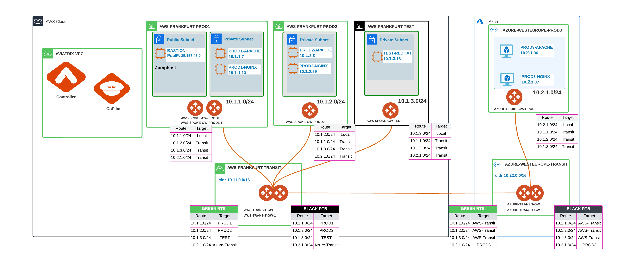
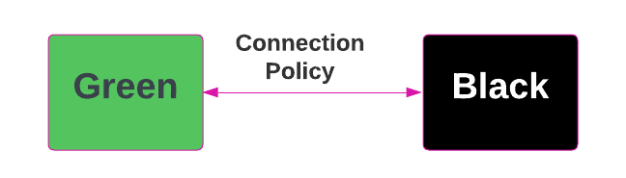
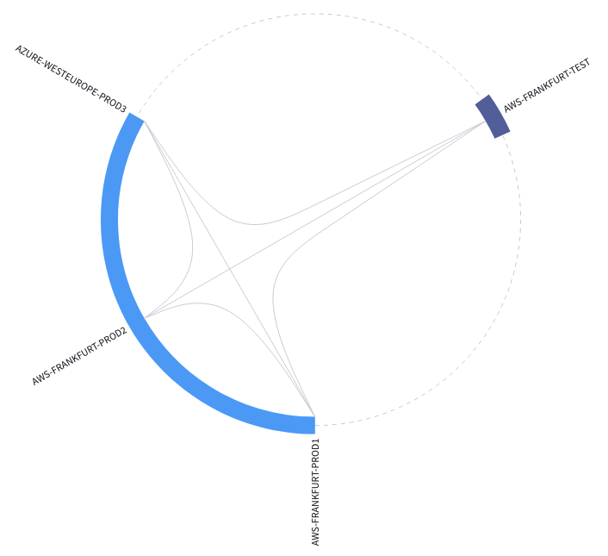
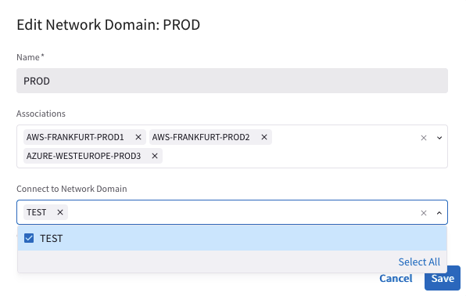
3. Apply the Connection Policy
Optionally, enable the Connection Policy:
Network Domains’ routing tables are merged (i.e. vrf leaking).

Slide 10


Aviatrix Certified Engineer (ACE)
COMMUNITY
https://aviatrix.com/ACE
https://community.aviatrix.com

Slide 11


Packet Walk
AZ-Spoke-2
[SOURCE] workload-1: 172.16.7.20
[DESTINATION] AWS-Spoke: 10.154.90.201
172.16.7.20 sends a packet using RFC 1918 summary routes to Aviatrix Spoke Gateway in its own AZ
AZ-Spoke-AGW will forward the packet to AZ-Transit-AGW
AZ-Transit-AGW will forward the packet to its transit peer AWS-Transit
AWS-Transit gateway will forward the packet to AWS-Spoke gateway
10.154.90.201 will receive the packet from AWS-Spoke-AGW
AZ-Spoke
AWS-Spoke
172.16.7.20
10.154.90.201
AZ-Transit
AWS-Transit
65020
65013
172.16.10.0/16
10.160.0.0/16
Notes:
It does not matter whether you have created segments on the Transit GW or not. The Transit GW needs to have all the routes.

Slide 12


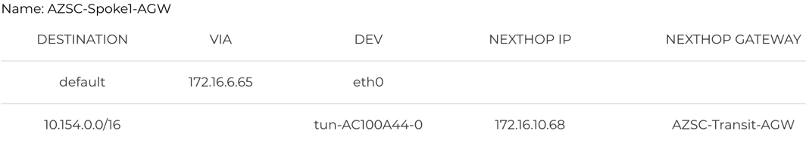

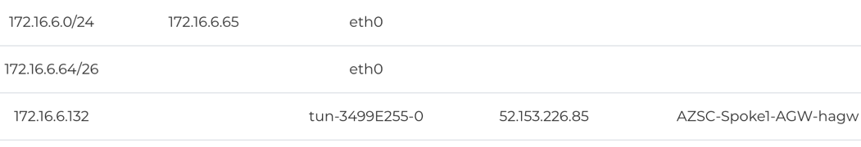

Multicloud Network Segmentation
OR-Spoke-1
OR-Spoke-3
OR-SS
AZSC-Spoke-1
AZSC-Spoke-2
10.150.89.134
10.152.24.64
10.154.90.201
172.16.6.20
172.16.7.20
OR-Transit
AZSC-Transit
65013
65020
Purple
10.160.0.0/16
172.16.10.0/23
Remote-Blue
Yellow
Local-Blue
64701
DATA CENTER
10.200.0.0/16
65050
Partner-1
10.201.0.0/16
Partner-2
10.202.0.0/16

Slide 13
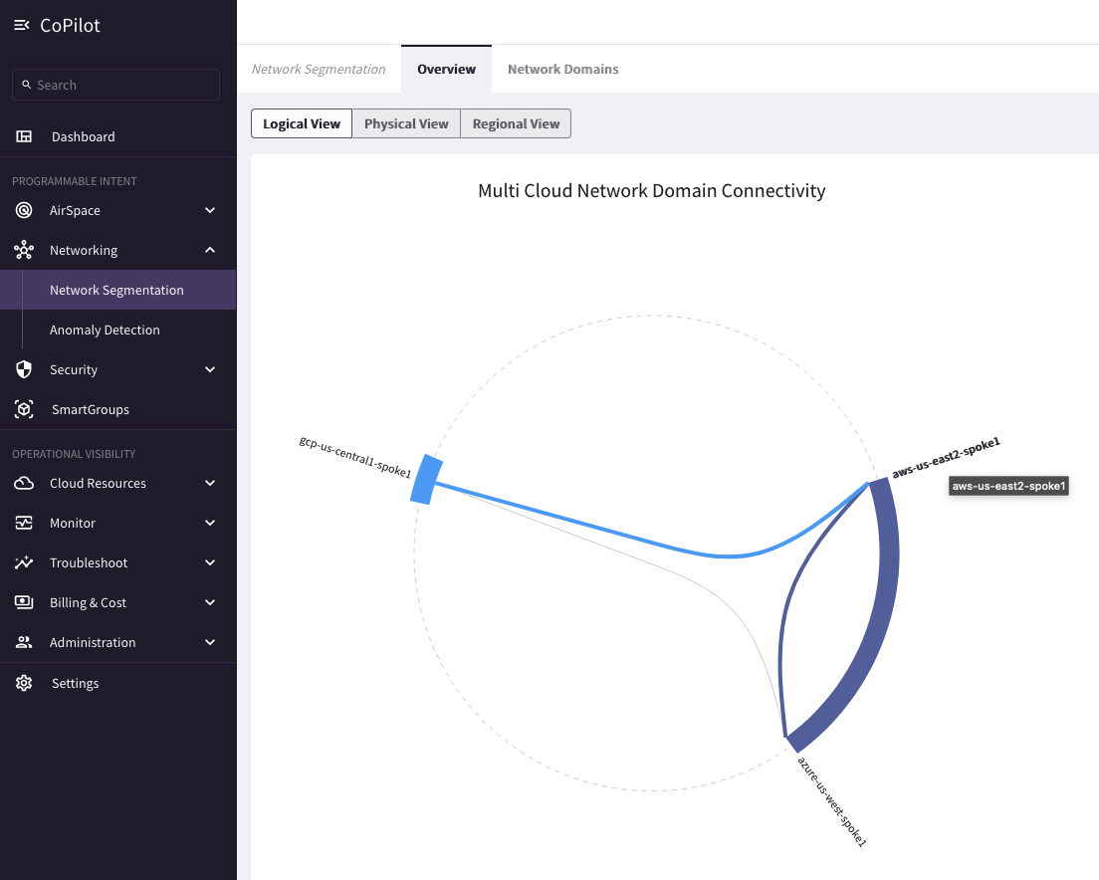
Visibility – CoPilot

Slide 14
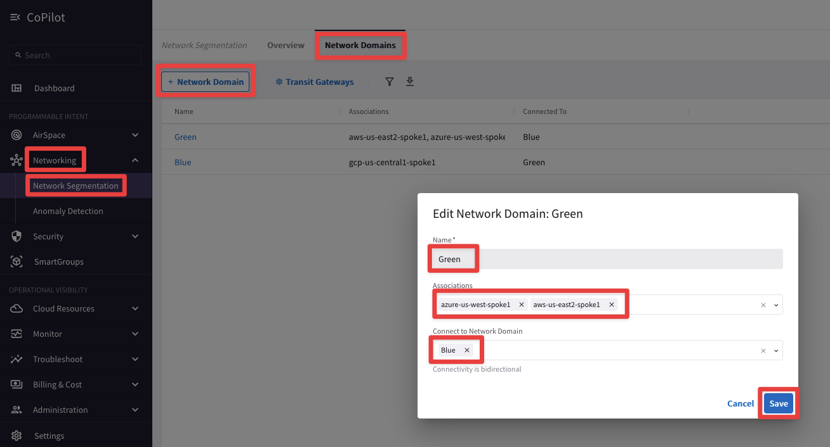
Configuration – CoPilot
Create Network Domains
Associate Spoke Gateways or Site2Cloud connections to Segments
(Optional) Create Connection Policy

